Slide 1
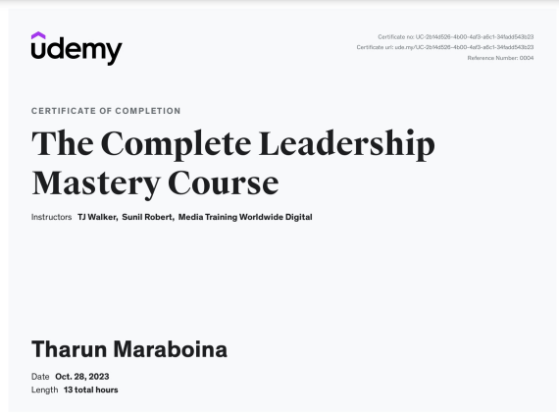

Slide 2



The Complete Leadership Mastery cource
Welcome to the Complete Leadership Mastery Course! In this course, you will learn the essential skills and strategies needed to become an effective leader in any organization. Get ready to unlock your leadership potential.

Slide 3
Introduction to Leadership Mastery Course
1
Why Leadership Matters
2
The Role of a Leader
Discover the importance of strong leadership in driving organizational success and creating a positive work culture.
Learn about the key responsibilities and qualities that define exceptional leaders and set them apart from the rest.
3
Building Self-Awareness
4
Creating a Leadership Development Plan
Explore techniques for self-reflection and assessment to better understand your own leadership style and strengths.
Develop a personalized roadmap for growth and improvement as a leader to achieve your professional goals.

Slide 4

Understanding Different Leadership Styles
1
Autocratic Leadership
Explore the strengths and limitations of this authoritative leadership style and when it can be effective.
2
Democratic Leadership
Learn how to foster collaboration and empower team members through participatory decision-making.
3
Transformational Leadership
Discover how influential leaders inspire and motivate others to achieve exceptional results and drive innovation.

Slide 5
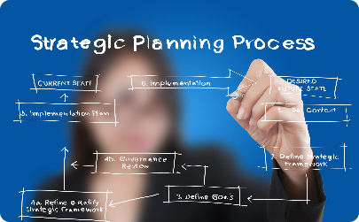
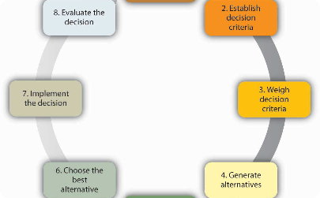
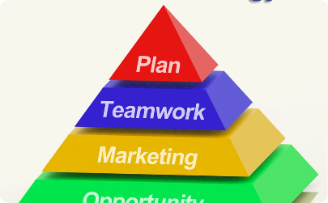
Strategic Planning and Decision-Making
Developing a Vision and Mission
Effective Decision-Making
Facilitating Strategic Planning Sessions
Discover various decision-making models and techniques to make informed and strategic choices in complex situations.
Learn how to create a compelling vision and mission statement that aligns with your organization's goals.
Gain practical strategies for leading and facilitating successful strategic planning sessions to drive organizational growth.

Slide 6
Conclusion and Next Steps
Reflecting on your Leadership Journey
Setting Long-Term Leadership Goals
Leveraging Leadership
Resource
Take time to reflect on your learning, growth, and accomplishments throughout the Leadership Mastery Course.
Establish ambitious yet attainable goals to continue developing your leadership skills beyond the course.
Discover a variety of resources, books, and networks to support your ongoing leadership development.

